Slide 1
Web Programming
Introduction 2
Zaheer Ahmed

Slide 2

CS406-Web Programming
Lecture 02
FAST-NU (Peshawar Campus)
Spring 2010

Slide 3
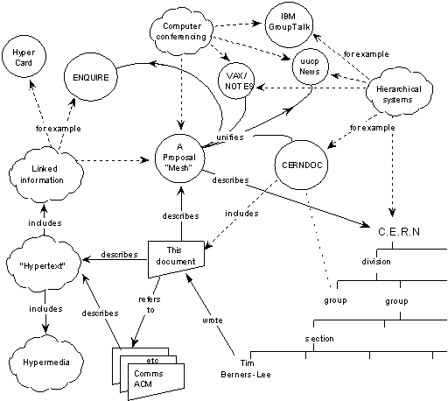
The Origin of the Web
Information Management: A Proposal
Tim Berners-Lee, CERN
May 1990
A proposal to build
a global hypertext
system for CERN
www.w3.org/History/1989/proposal.html

Slide 4
Tim Berners-Lee, CERN
In 1989, Tim Berners-Lee invented the World Wide Web, an Internet-based hypermedia initiative for global information sharing while at CERN, the European Particle Physics Laboratory. He wrote the first web client and server in 1990. His specifications of URIs, HTTP and HTML were refined as web technology spread. - See more at: http://internethalloffame.org/inductees/tim-berners-lee?gclid=CMrP8rvNrswCFeUy0wod4OEPVg#sthash.ZC1X2rEO.dpuf

Slide 5
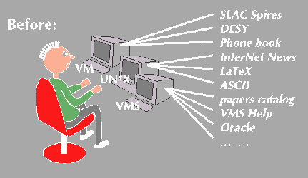
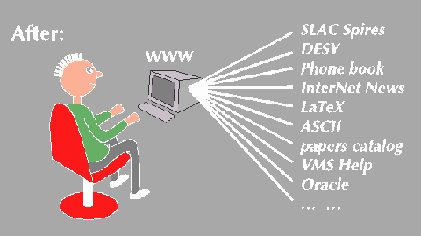
W3 Concepts
Universal Readership
www.w3.org/Talks/General/Concepts.html

Slide 6
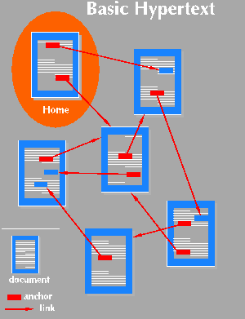
W3 Concepts
Hypertext
Hypertext is text with links.
Not a new idea read a book there are links between references (see section 3), footnotes, and between the table of contents or index and the text.
With hypertext, reader can escape from the sequential organization of the pages to follow pursue a thread of his or her own.
www.w3.org/Talks/General/Concepts.html

Slide 7
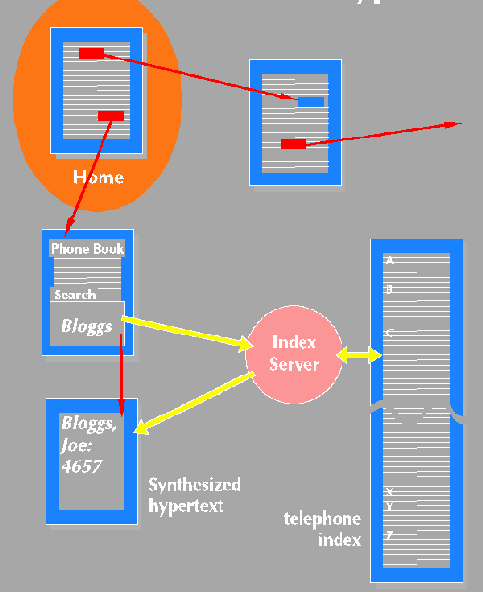
W3 Concepts
Searching
www.w3.org/Talks/General/Concepts.html

Slide 8
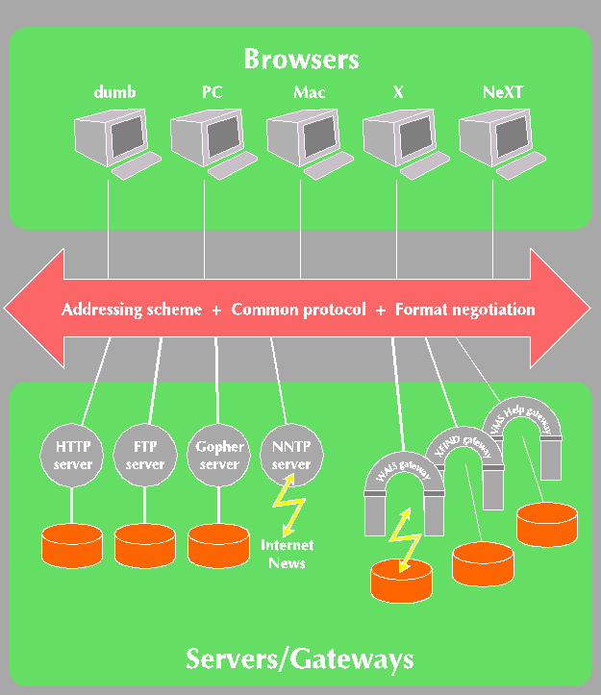
W3 Concepts
Client-Server Model
www.w3.org/Talks/General/Concepts.html

Slide 9
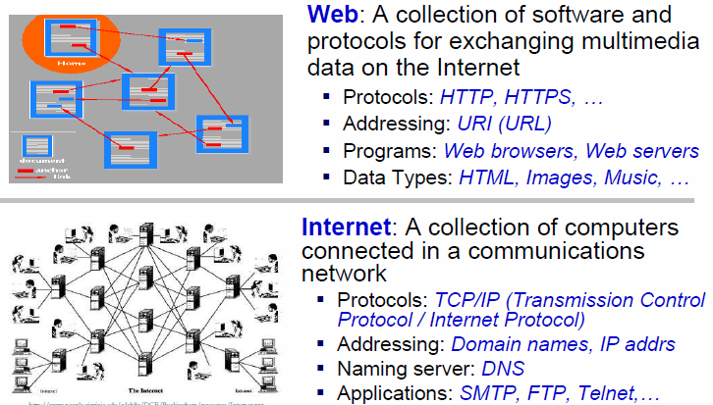
Web vs. Internet
SMTP stands for Simple Mail Transfer Protocol. SMTP is used when email is delivered from an email client, such as Outlook Express, to an email server or when email is delivered from one email server to another. SMTP uses port 25.
© In-Young Ko, Information and Communications University

Slide 10
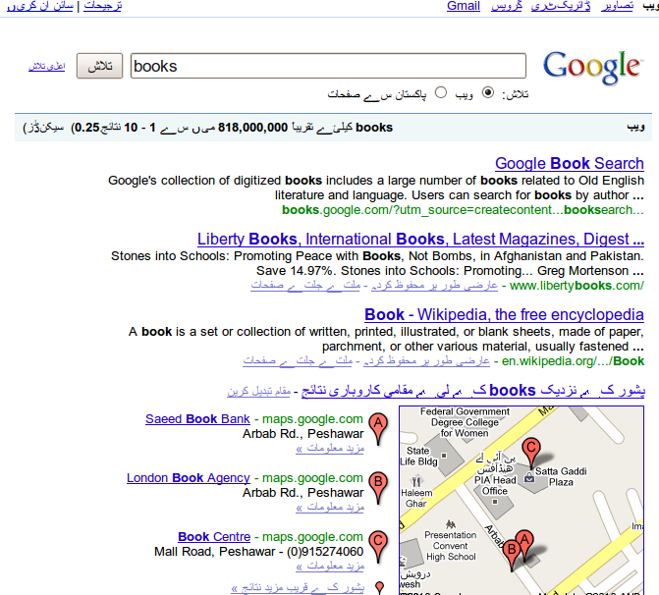
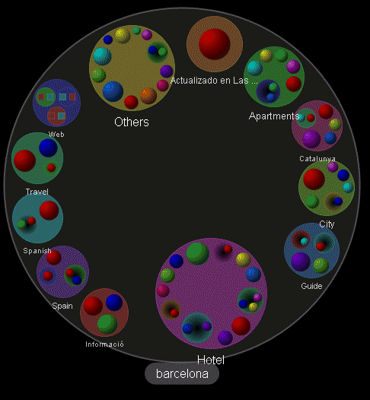
Textual vs. Graphical
google.com.pk
Grokker.com

Slide 11
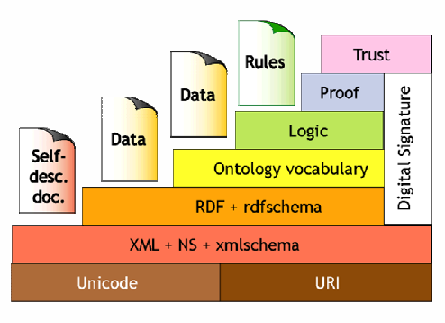
Semantic Web
The Resource Description Framework (RDF) is a family of World Wide Web Consortium (W3C) specifications originally designed as a metadata data model.

Slide 12
Past & Future of the Web
Past
Broadcast of read-only materials
Exchange information for human consumption
Future
More interactions
Machine-readable information
Mobile Web
© In-Young Ko, Information and Communications University

Slide 13
The Future of the Web
Mobile Web
enables users to access the Web from their mobile devices such as cell phones and PDAs (Personal Digital Assistants)
Service-Oriented Web
makes various services accessible via the Web using the standard Web Services protocols
Semantic Web
makes machine understandable (processable) information available on the Web
© In-Young Ko, Information and Communications University

Slide 14
Client-side Information Presentation
Introduction to Internet
HTTP (Hypertext Transfer Protocol)
HTML (Hypertext Markup Language)
CSS (Cascading Style Sheets)
........

